Slide 1

Autonomous navigation system for rover
24aim113 – introduction to nn , cnn and gnn
24aim114 – analog system design
Team members :
Akhillesh varathan cs – cb.ai.u4aim24102
Jeffrin merino j – cb.ai.u4aim24118
K Deepak Skandh – cb.ai.u4aim24119
Kavin m – cb.ai.u4aim24121

Slide 2
Introduction :
Autonomy refers to the ability of a system, machine, or robot to operate independently without human intervention. It involves Decision-making, Self-navigation and Path Planning.
Autonomy enables machines to perform tasks such as obstacle avoidance, path planning, and real-time adjustments, making them useful in various applications like space exploration, self-driving cars and industrial automation. adaptive responses to environmental changes.

Slide 3
Literature review:
S.NO | TITLE | AUTHOR | TECHNIQUES USED
1. | Obstacle Avoidance and Path Planning Methods for Autonomous Navigation of Mobile Robot | PETER CORONDI HUSAM A NAEMAH KORNEL KATONA. JUNE-2024 | The authors have implemented cuckoo algorithm for path planning while artificial potential field to handle the unknown obstacles.
2. | Enhancing Real-time Object Detection with YOLO Algorithm | Gudala Lavayana. Sagar Dhanraj Pande. OCT-2023 | The Authors have discussed potential use of YOLO in Objection detection and its significant uses in real time environment.
3. | A Neural network based Navigation System for Autonomous Mobile Robot Systems | Yiyang Chen. Yueyan Zhang. August - 2023 | The Authors have implemented Fuzzy Neural network along with Q-Learning for the Effective navigation.

Slide 4
4. | Autonomous Rover Navigation Using GPS based Path Planning. | Abdul Al Arabi. Pranabesh Sarkar 2021-JAN | The Authors have Implemented GPS for Path Planning.
5. | A high-accuracy autonomous navigation scheme for the Mars rover. | Yunan Zhao. Qunsheng Li. Xinlong Wang March - 2023 | The authors have implemented binocular visual odometry for precise motion estimation.

Slide 5
Research gaps:
motion planning in dynamic environments.
large scale mapping and navigation.
Multi-modal sensor fusion.
human – rover interaction.
adaptation of system in changing conditions.

Slide 6
Problem statement:
Real life Problems our Project Aims to Tackle:
Improved Path Planning By Implementing Neural Network with An Traditional Path finding Algorithm.
Implementing Sensors Along With Reinforcement Learning To Track Undetected Obstacles and handle Real life Dynamic changes.
Implementing Various Sensors to have a Track of the Surroundings.

Slide 7
Work flow :
NAVIGATION
OBSTACLE DETECTION
QUICK DECISION MAKING
HANDILING DYNAMIC CHANGES
PATH PLANNING
FOR EFFICIENT MOVEMENT
Raspberry pi is used to integrate sensors ,RL,NN for Effective Navigation.
Ultrasonic sensor along with RL is used for obstacle detection while camera module +NN used for path planning
By integrating them together effective Navigation can be achieved.

Slide 8
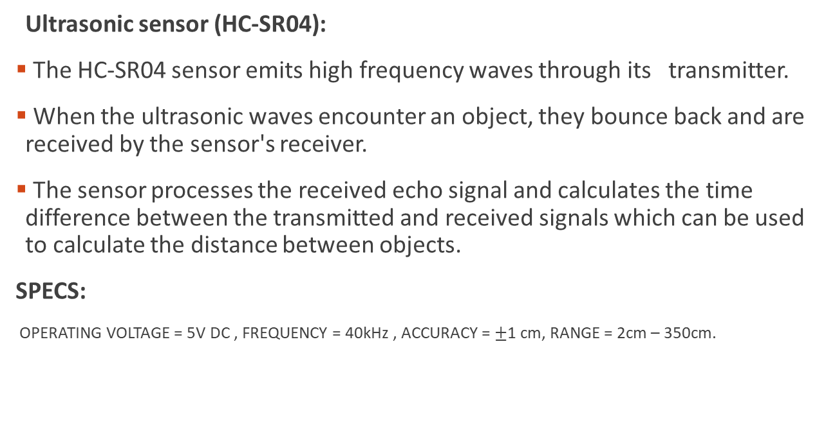
HARDWARE IMPLEMENATION:
Ultrasonic sensor (HC-SR04):
The HC-SR04 sensor emits high frequency waves through its transmitter.
When the ultrasonic waves encounter an object, they bounce back and are received by the sensor's receiver.
The sensor processes the received echo signal and calculates the time difference between the transmitted and received signals which can be used to calculate the distance between objects.
SPECS:
OPERATING VOLTAGE = 5V DC , FREQUENCY = 40kHz , ACCURACY = $±$1 cm, RANGE = 2cm – 350cm.

Slide 9
HARDWARE IMPLEMENTATION :
RASPBERRY PI:
Used As an single-board computer to integrate the sensors and Algorithms used in the project.
Handles the commands and operation of Rover.
RASPBERRY PI V1 Camera module Specifications:
Resolution : 5MP
Lens : Fixed Focus
Dimensions : 25mm x 25mm x 9mm.

Slide 10
Others:
Sensors:
IR sensors.
Magnetic sensor.
Temperature sensor.
Humidity sensor.
Pressure sensor.
ROVER COMPONENTS:
Chassis , Wheels, Dual shaft 60 rpm motors , servo motors.

Slide 11
Working principle :
ENVIRONMENT
CAPTURE IMAGE
PROCESS IN YOLO
GRID REPRESENTATION
DYNAMIC CHANGE
FIND THE OPTIMAL PATH
APPLY TO A*ALGORITHM
NO
YES
SENSORS+ RL FOR LOCAL DECISION
REPLAN

Slide 12
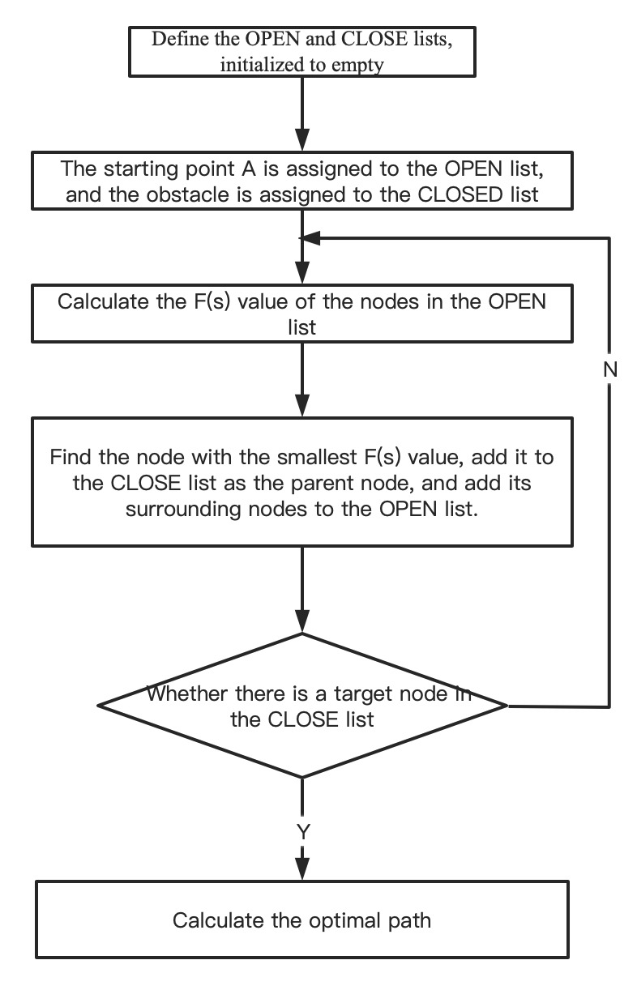
METHODOLOGY: A*ALGORITHM:

Slide 13
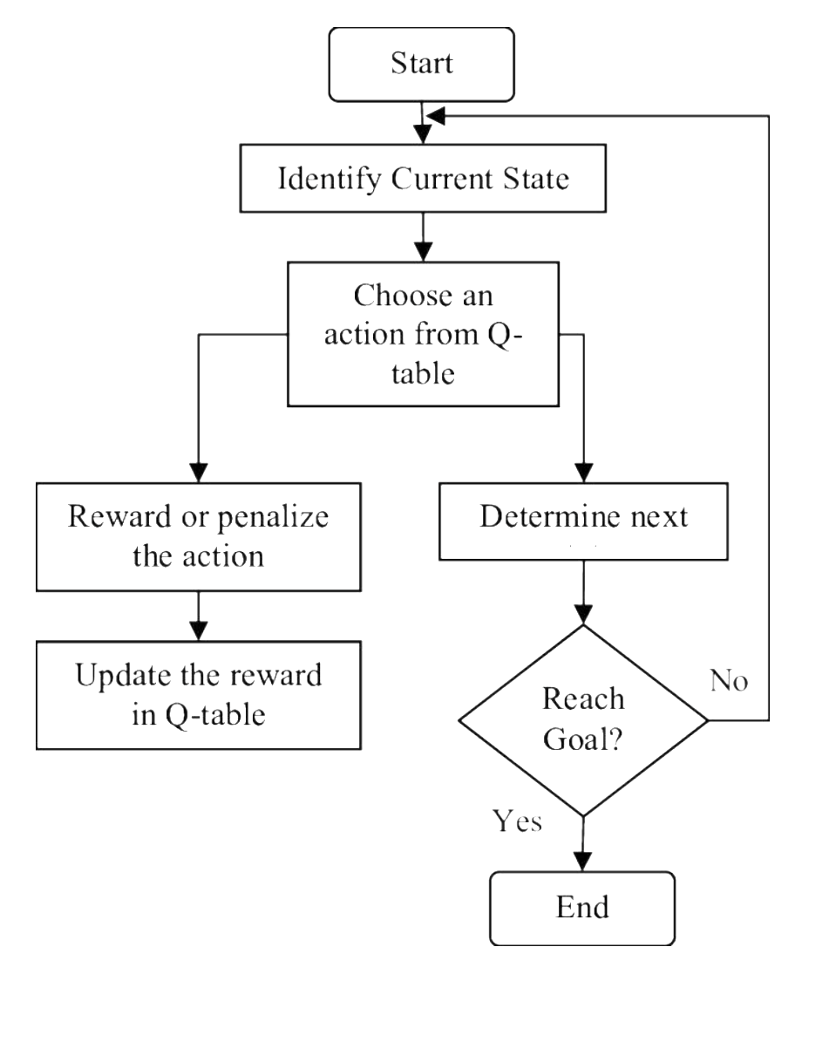
Q – LEARNING:

Slide 14
YOLO ( YOU ONLY LOOK ONCE ):
YOLO is an Real time objection detection Algorithm that uses Neural Network to predict both Bounding boxes and Class Prediction.
Architecture of YoloV5:
The backbone is a CNN that extracts features from input image. Yolov5 uses CSPDarknet53 as an backbone.
CSP block Architectures are used to reduce the number of parameters and improve the network performance.
The neck is responsible for Feature Refinement ,fusion and Up sampling.
The Head is responsible for object detection, bounding box prediction and confidence scores.

Slide 15
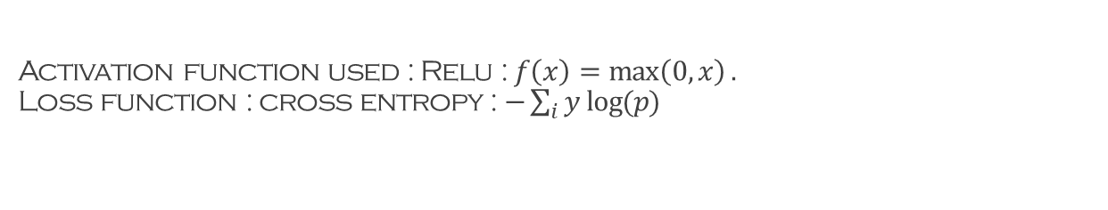
Activation function used : Relu : $f\left(x\right)=\max\left(0,x\right).$ Loss function : cross entropy : $−\sum_{i}{y log⁡(p)}$
Input Image
Resize and normalize image
Pass through Backbone
Feature Extraction
Output Detection
NON-MAX Suppression
Class Probabilities
Pass through Neck

Slide 16
THANK YOU

